Slide 1

TOPIC :- ANTI-THEFT FLOORING SYSTEM
YEAR/SEMESTER :- 3RD/6TH
SUBJECT:- MINOR PROJECT
GROUP MEMBERS :-
AKANSHA SHARMA :- 0108IO201007
JATIN SURYAVANSHI:- 0108IO201025
SADHNA KUSHWAHA:- 0108IO201054
SRISHTI LODHI :- 0108IO201064
PRESENTED TO :- ABHISHEK MATHUR SIR

Slide 2
1. Introduction
2. Components used
3. How it Works
4. Benefits of the Anti-theft
Flooring System
5. Applications of the Anti- theft Flooring System
6. Future Developments
7. Conclusion

Slide 3
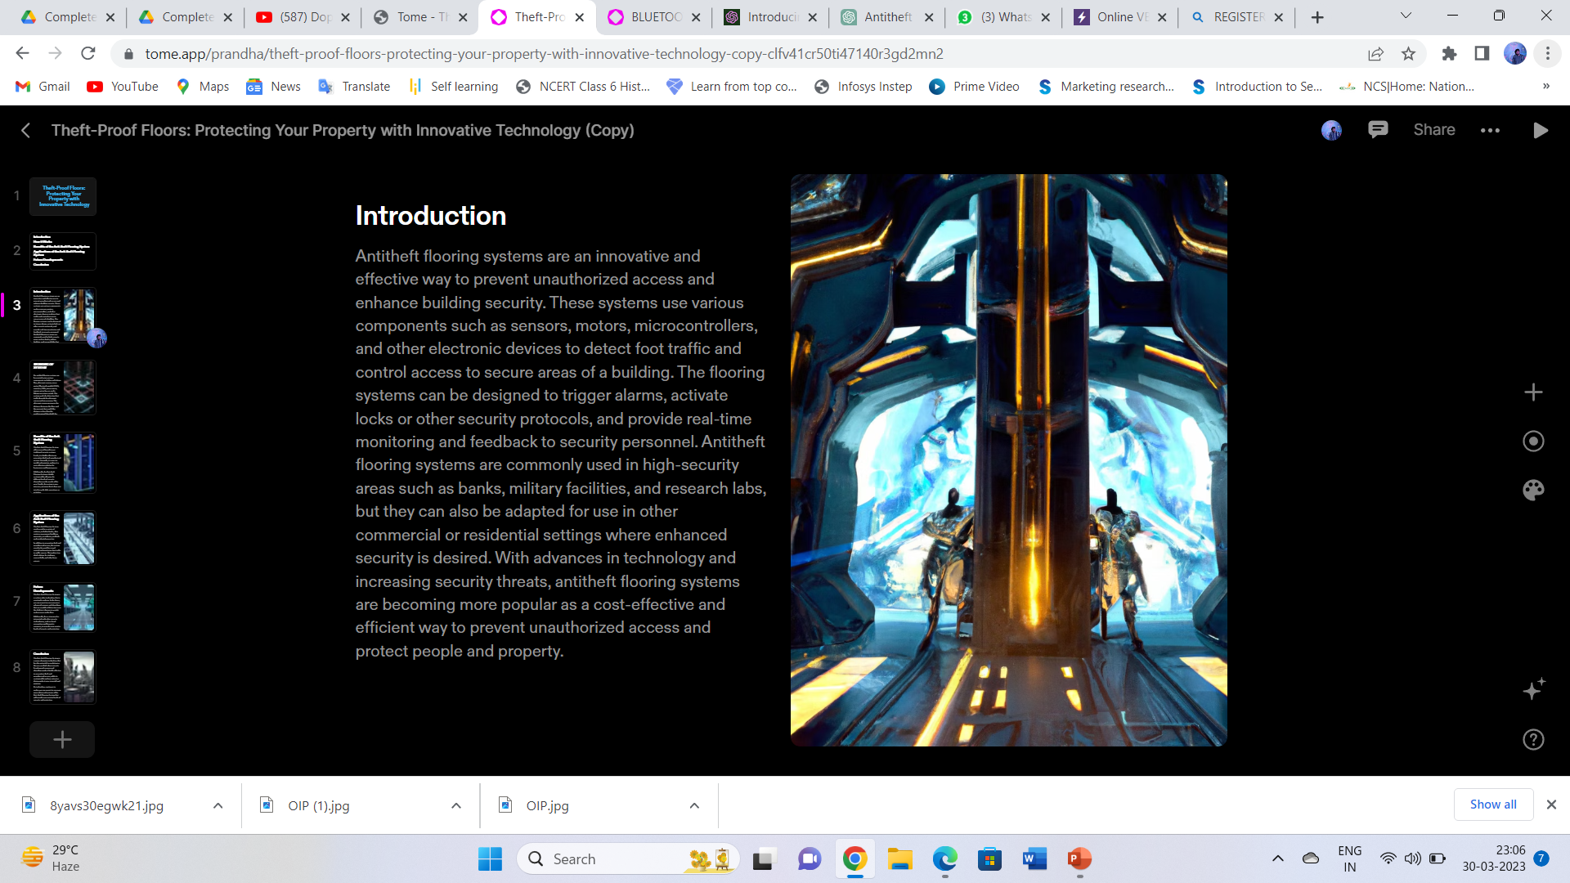

Slide 4
C0MPONENTS USED
Arduino UNO
Ultrasonic sensor
Servo motor
Bluetooth module HC05
Registers And LED’s
Piezo sensor
Jumper wires
Buzzer
Power supply lithium-ion

Slide 5
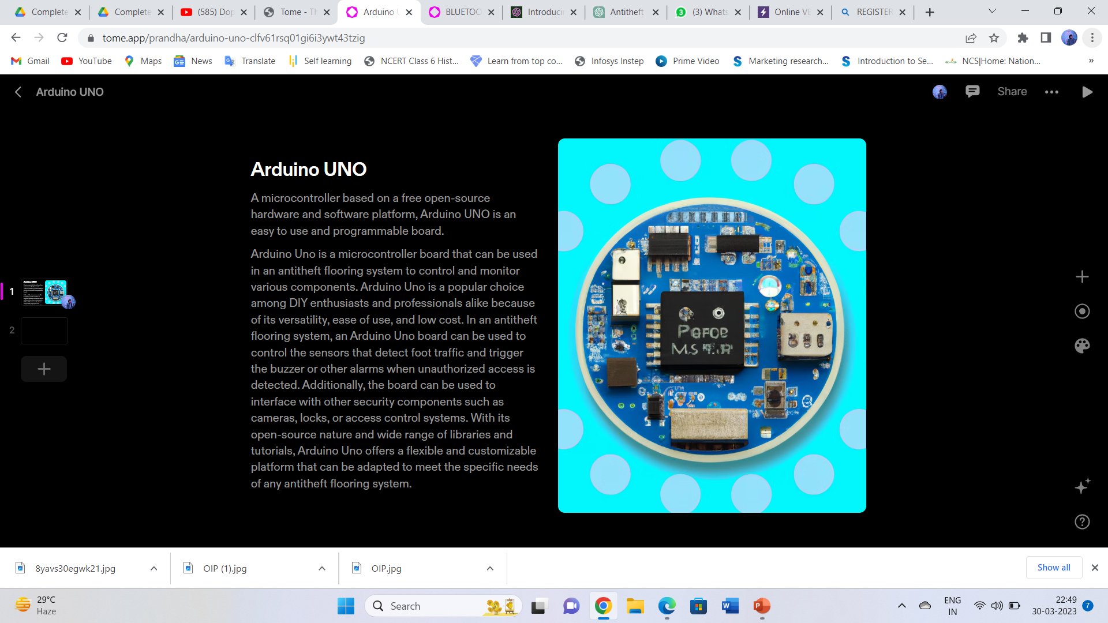

Slide 6
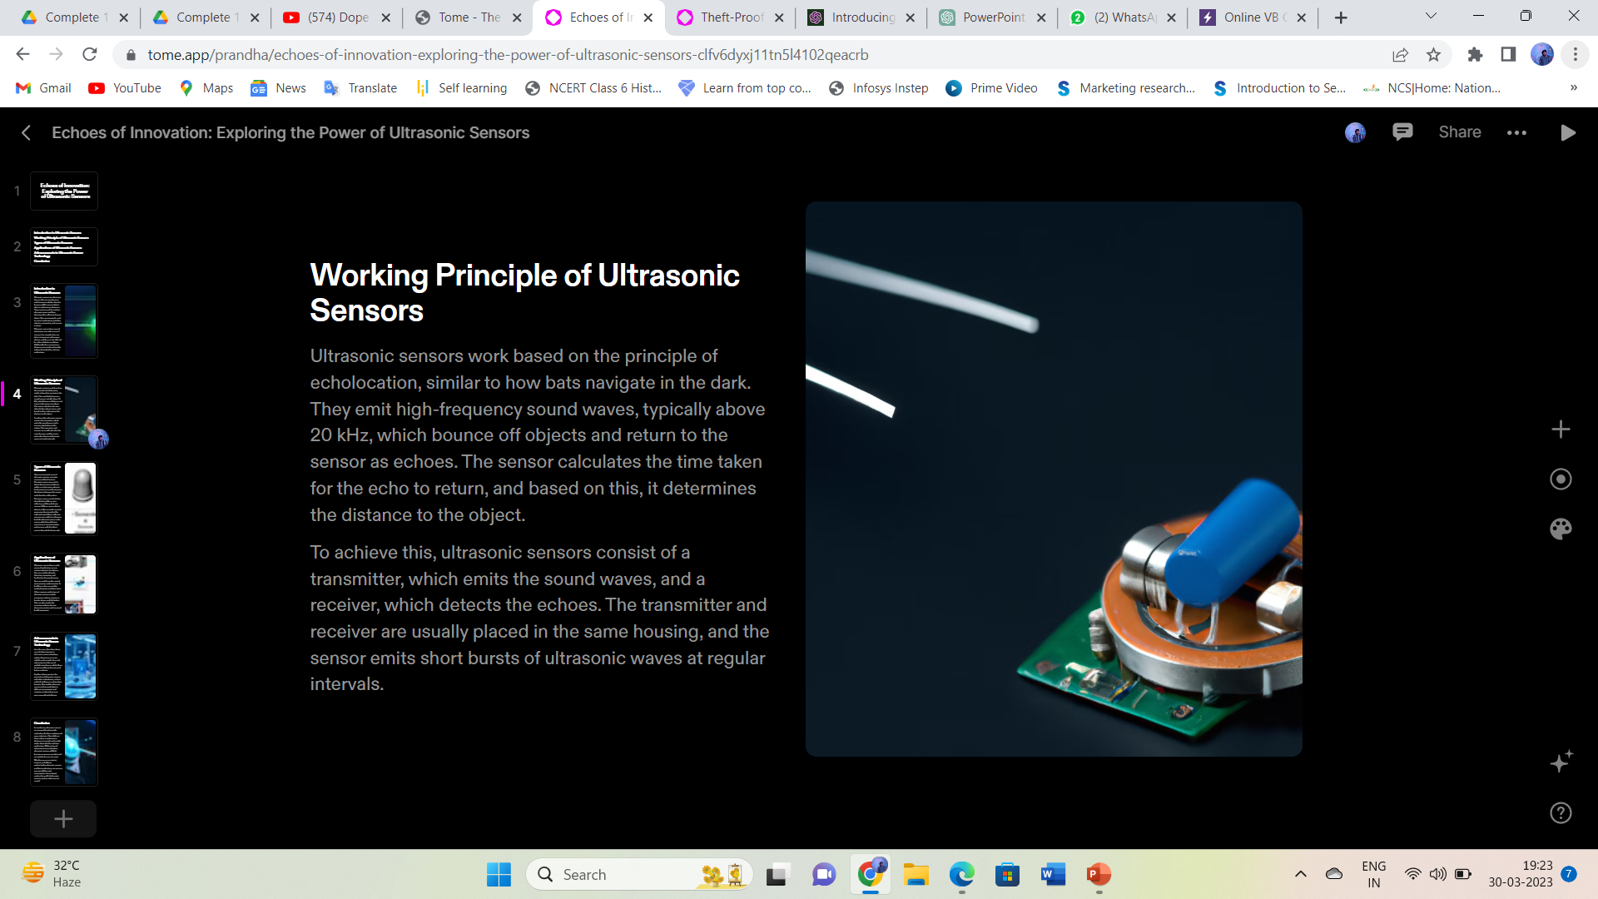

Slide 7
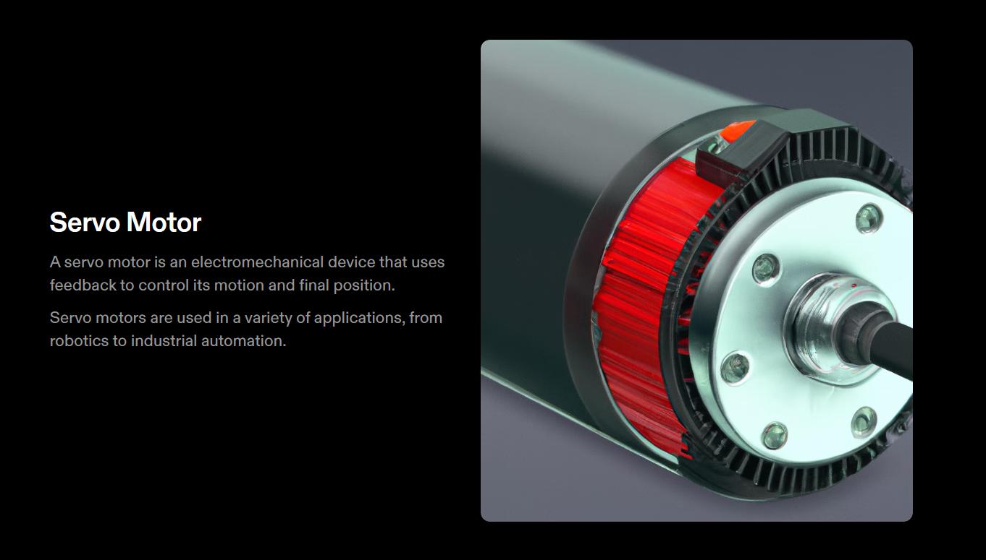

Slide 8
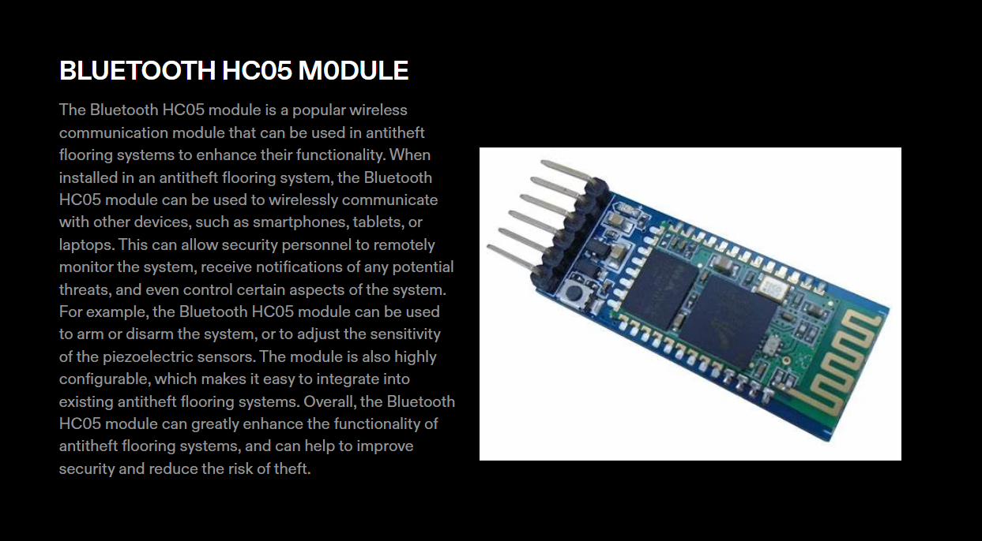

Slide 9
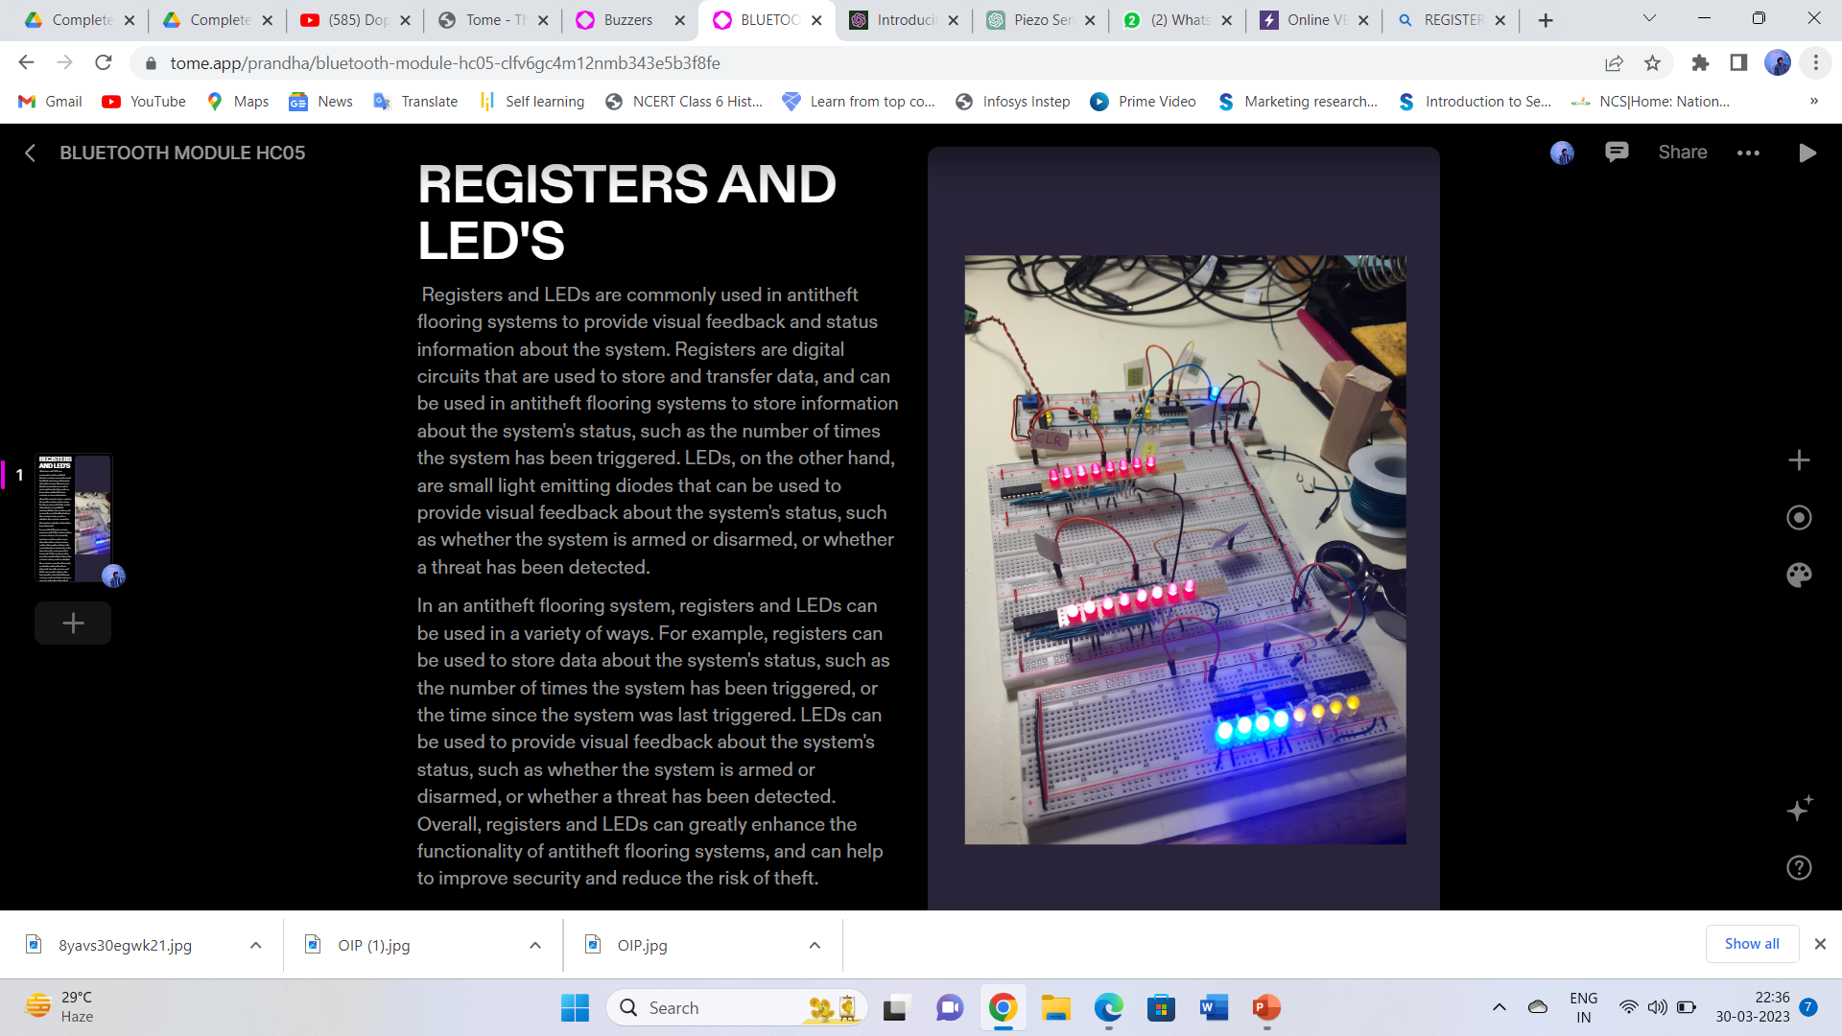

Slide 10
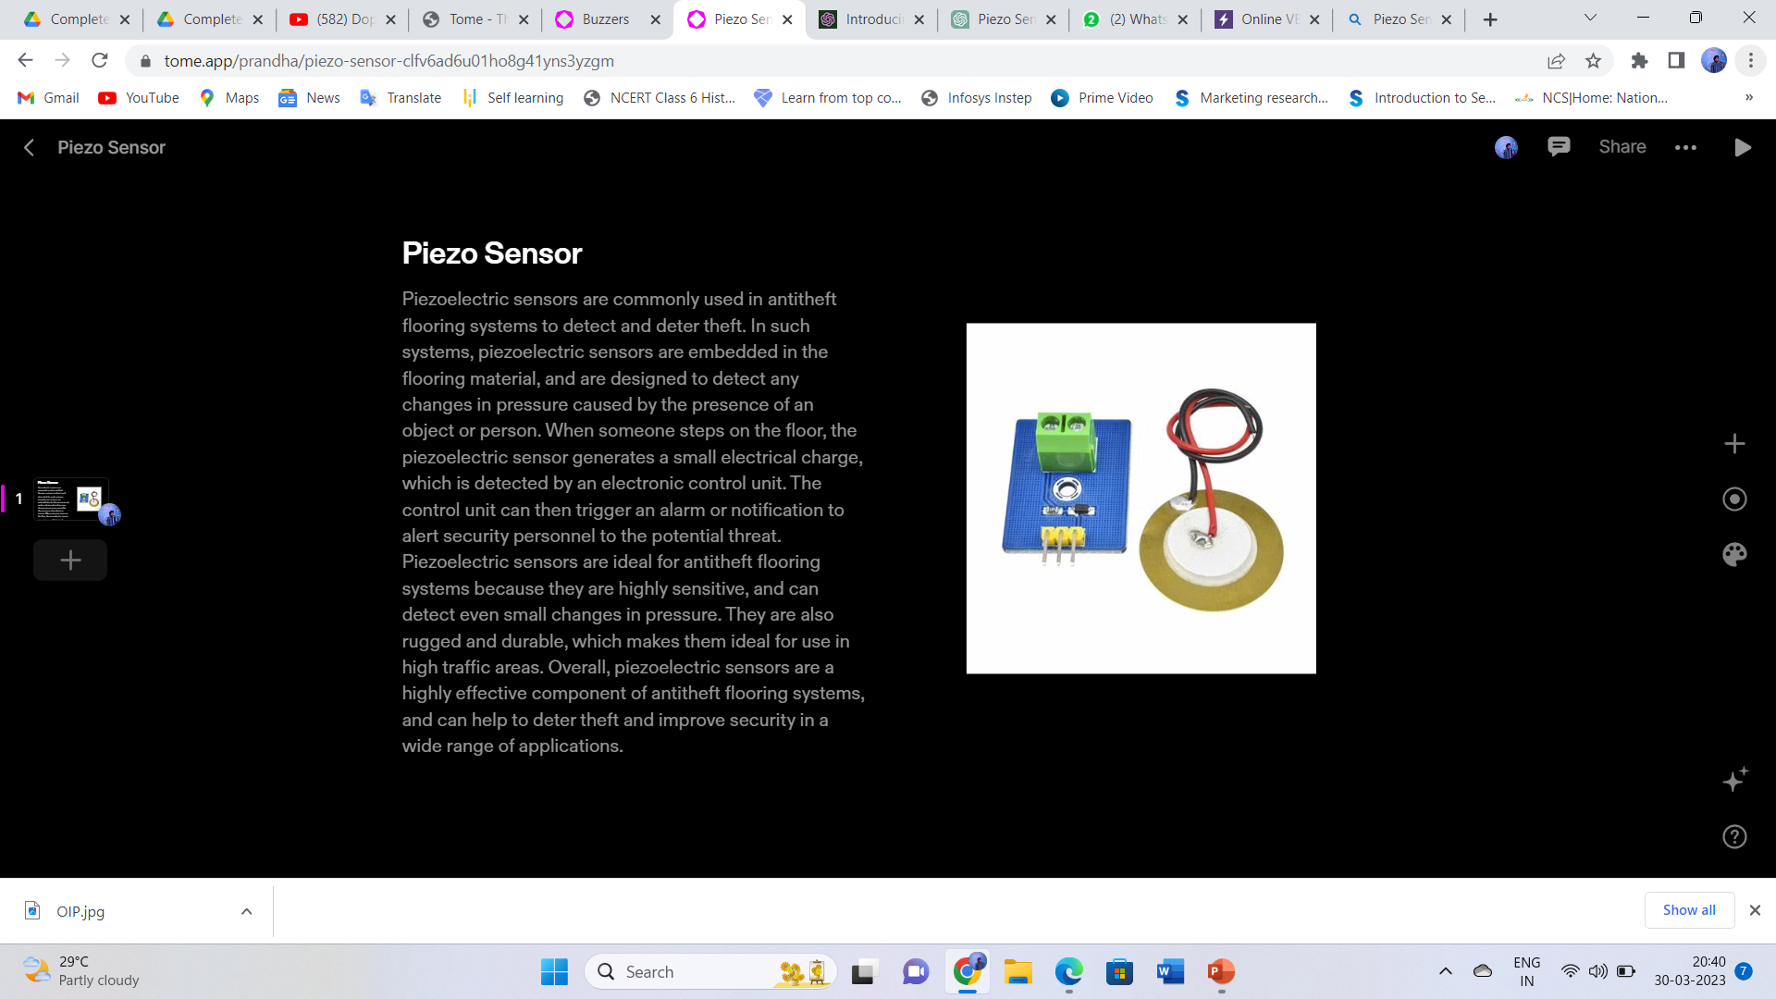

Slide 11
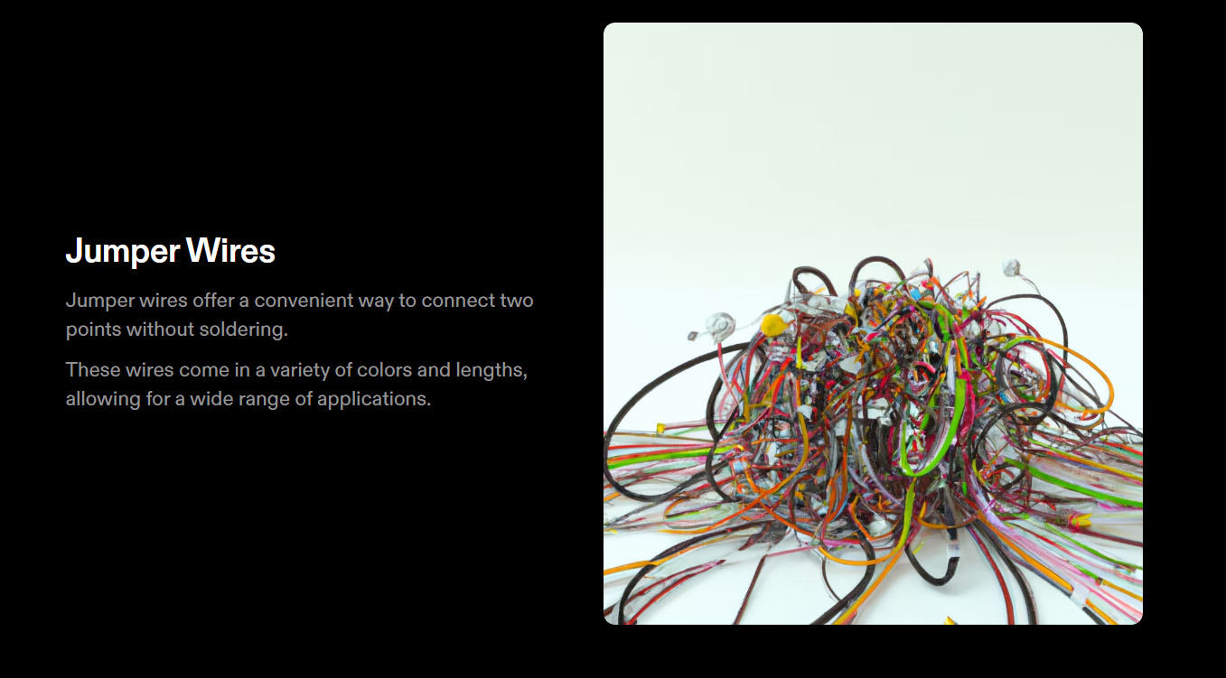

Slide 12
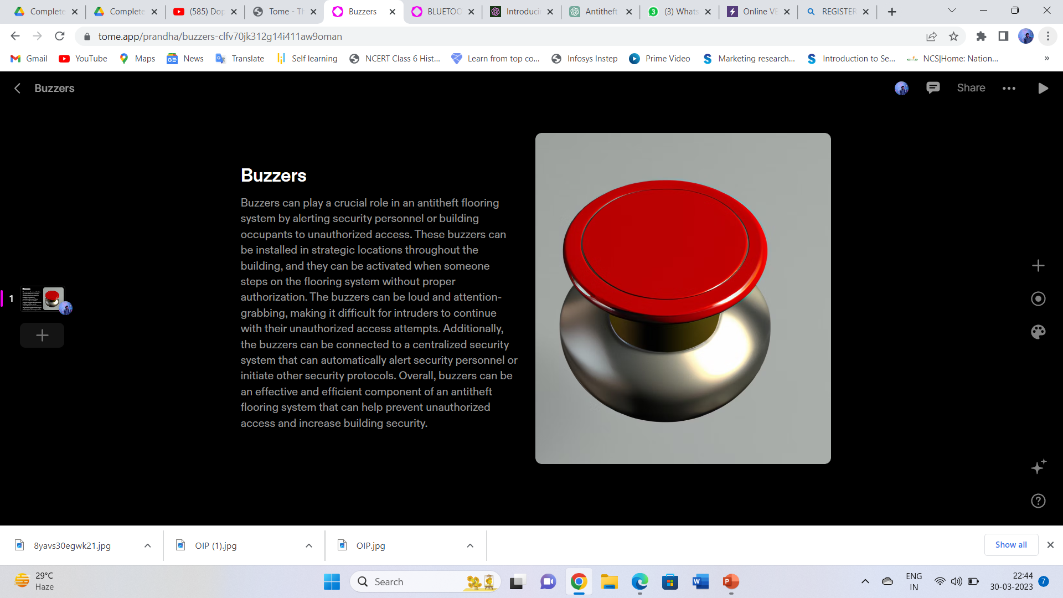

Slide 13
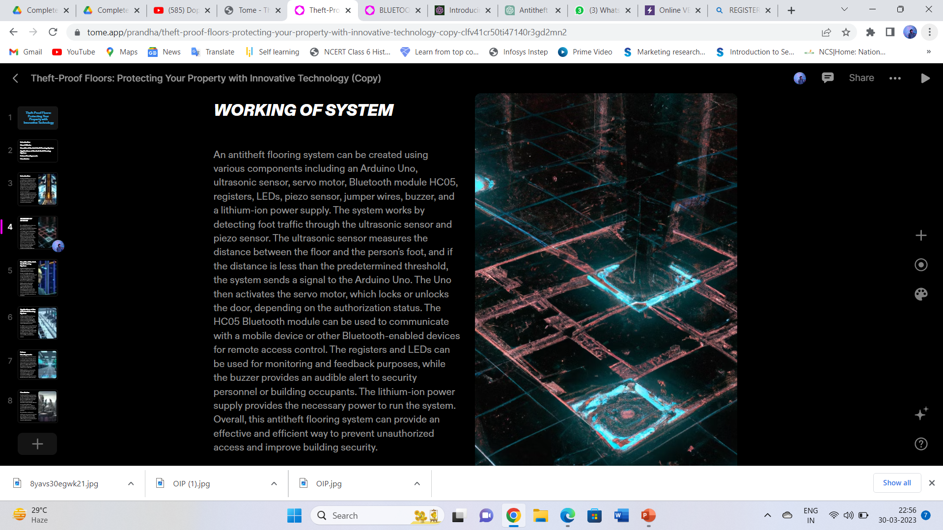

Slide 14
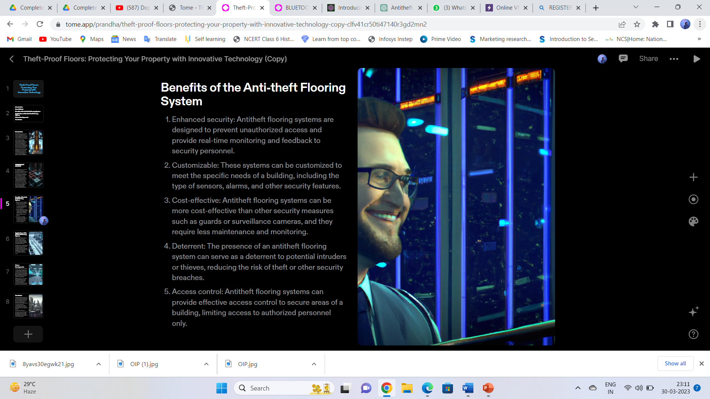

Slide 15
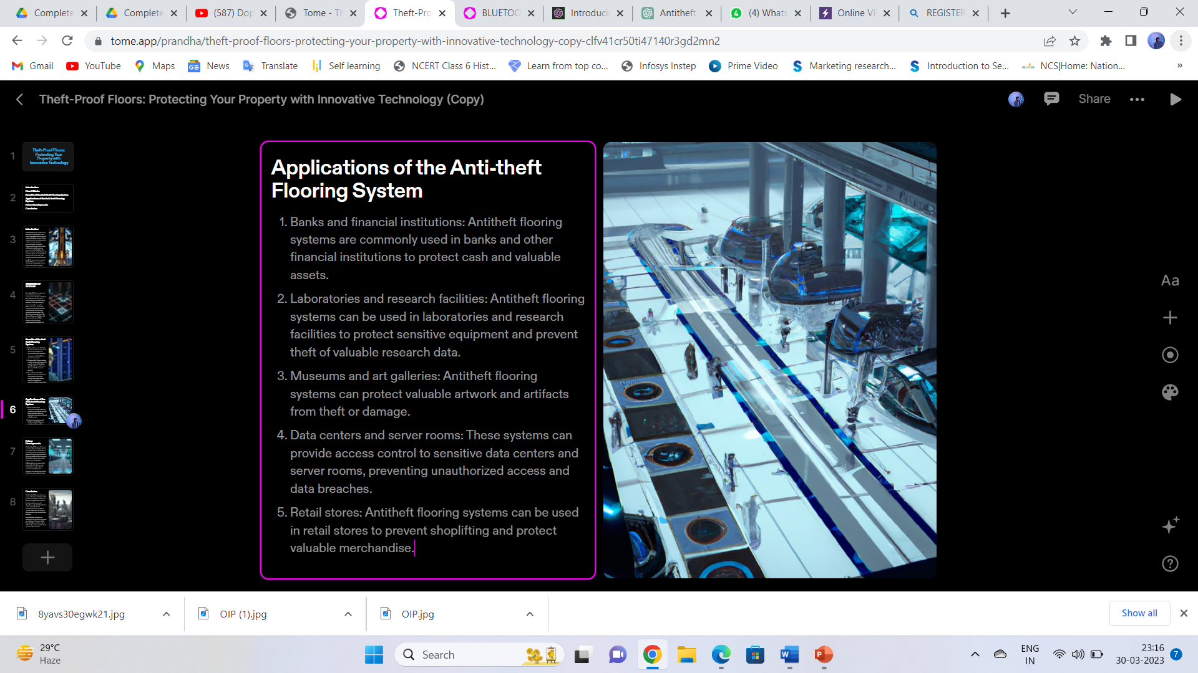

Slide 16
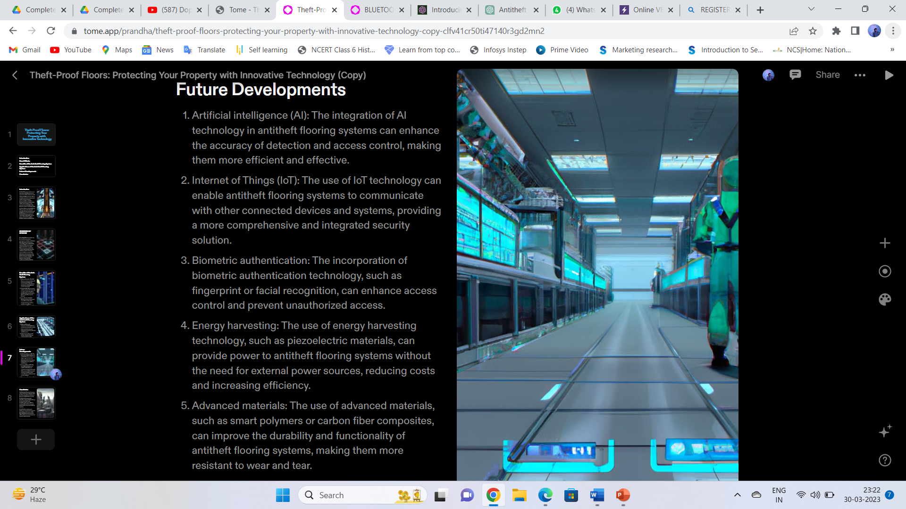

Slide 17
